Slide 1
Fragment Assembly of DNA
BIO/CS 471 – Algorithms for Bioinformatics

Slide 2
Limitations to sequencing
You must have a primer of known sequence to initiate PCR
Only about 1000nts can be sequenced in a single reaction
The sequencing process is slow, so it is beneficial to do as much in parallel as possible
  Primer hopping
  Shotgun approach

Slide 3
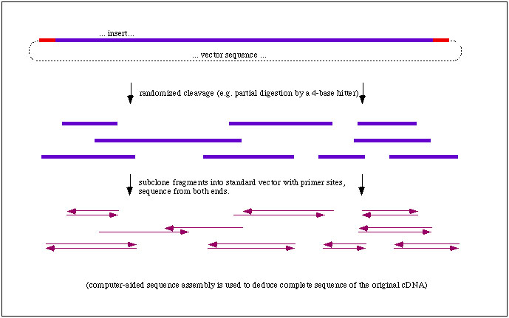
Shotgun Sequencing

Slide 4
The Ideal Case
Find maximal overlaps between fragments:
ACCGT
CGTGC
TTAC
TACCGT
--ACCGT--
----CGTGC
TTAC-----
-TACCGT—
TTACCGTGC
Consensus sequence determined by vote

Slide 5
Quality Metrics
The coverage at position i of the target or consensus sequence is the number of fragments that overlap that position
Two contigs
Target:
No coverage

Slide 6
Quality Metrics
Linkage – the degree of overlap between fragments
Target:
Perfect coverage, poor average linkage
poor minimum linkage

Slide 7
Real World Complications
Base call errors
Chimeric fragments, contamination (e.g. from the vector)
--ACCGT--
----CGTGC
TTAC-----
-TGCCGT—
TTACCGTGC
--ACC-GT--
----CAGTGC
TTAC------
-TACC-GT—
TTACC-GTGC
--ACCGT--
----CGTGC
TTAC-----
-TAC-GT—
TTACCGTGC
Base Call Error
Insertion Error
Deletion Error

Slide 8
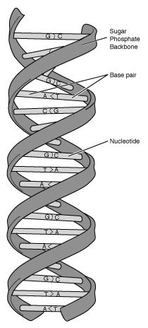
Unknown Orientation
A fragment can come from either strand
CACGT
ACGT
ACTACG
GTACT
ACTGA
CTGA
→ CACGT
→ -ACGT
← --CGTAGT
← -----AGTAC
→ --------ACTGA
→ ---------CTGA

Slide 9
Repeats
Direct repeats
A
X
B
X
C
X
D
A
X
C
X
B
X
D

Slide 10
Repeats
Direct repeats
A
X
B
Y
C
X
D
Y
E
A
X
D
Y
C
X
B
Y
E

Slide 11
Repeats
Inverted repeats
X
X
X
X

Slide 12
Sequence Alignment Models
Shortest common superstring
  Input: A collection, F, of strings (fragments)
  Output: A shortest possible string S such that for every f ∈ F, S is a superstring of f.
Example:
  F = {ACT, CTA, AGT}
  S = ACTAGT

Slide 13
Problems with the SCS model
x
x
x
x´
Directionality of fragments must be known
No consideration of coverage
Some simple consideration of linkage
No consideration of base call errors

Slide 14
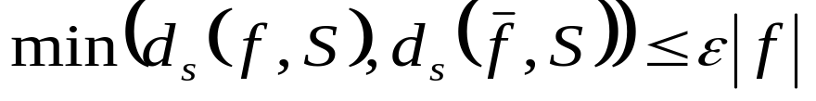
Reconstruction
Deals with errors and unknown orientation
Definitions
  f is an approximate substring of S at error level ε when d_{s}(f, S) ≤ ε × | f |
  d_{s} = substring edit distance:
Reconstruction
  Input: A collection, F, of strings, and a tolerance level, ε
  Output: Shortest possible string, S, such that for every f ∈ F :
Match = 0
Mismatch = 1
Gap = 1

Slide 15
Reconstruction Example
Input: F = {ATCAT, GTCG, CGAG, TACCA}
ε = 0.25
Output:
ATCAT
ATGAT
------CGAC
-CGAG
----TACCA
ACGATACGAC
GTCG
d_{s}(CGAG, ACGATACGAC) = 1
= 0.25 × 4
So this output is OK for ε = 0.25

Slide 16
Gaps in Reconstruction
Reconstruction allows gaps in fragments:
AT-GA-----
ATCGATAGAC
d_{s} = 1

Slide 17
Limitations of Reconstruction
Models errors and unknown orientation
Doesn’t handle repeats
Doesn’t model coverage
Only handles linkage in a very simple way
Always produces a single contig

Slide 18
Contigs
Sometimes you just can’t put all of the fragments together into one contiguous sequence:
No way to tell how much sequence is missing between them.
?
No way to tell the order of these two contigs.

Slide 19
Multicontig
Definitions
  A layout, L, is a multiple alignment of the fragments
    Columns numbered from 1 to |L |
  Endpoints of a fragment: l(f) and r(f)
  An overlap is a link is no other fragment completely covers the overlap
Link Not a link

Slide 20
Multicontig
More definitions
  The size of a link is the number of overlapping positions
  The weakest link is the smallest link in the layout
  A t-contig has a weakest link of size t
  A collection, F, admits a t-contig if a t-contig can be constructed from the fragments in F
ACGTATAGCATGA
GTA CATGATCA
ACGTATAG GATCA
A link of size 5

Slide 21
Perfect Multicontig
Input: F, and t
Output: a minimum number of collections, C_{i}, such that every C_{i} admits a t-contig
Let F = {GTAC, TAATG, TGTAA}
t = 3
t = 1
--TAATG
TGTAA--
TGTAA-----
--TAATG---
------GTAC
GTAC

Slide 22
Handling errors in Multicontig
The image of a fragment is the portion of the consensus sequence, S, corresponding to the fragment in the layout
S is an ε-consensus for a collection of fragments when the edit distance from each fragment, f, and its image is at most ε × | f |
TATAGCATCAT
CGTC CATGATCA
ACGGATAG GTCCA
ACGTATAGCATGATCA
An ε-consensus
for ε = 0.4

Slide 23
Definition of Multicontig
Input: A collection, F , of strings, an integer t ≥ 0, and an error tolerance ε between 0 and 1
Output: A partition of F into the minimum number of collections C_{i} such that every C_{i} admits a t-contig with an ε-consensus

Slide 24
Example of Multicontig
Let ε = 0.4, t = 3
TATAGCATCAT
ACGTC CATGATCAG
ACGGATAG GTCCAG
ACGTATAGCATGATCAG

Slide 25
Algorithms
Most of the algorithms to solve the fragment assembly problem are based on a graph model
A graph, G, is a collection of edges, e, and vertices, v.
  Directed or undirected
  Weighted or unweighted
We will discuss
representations and
other issues shortly…
A directed, unweighted graph

Slide 26
The Maximum Overlap Graph
The text calls it an overlap multigraph
Each directed edge, (u,v) is weighted with the length of the maximal overlap between a suffix of u and a prefix of v
TACGA
a
1
2
ACCC
CTAAAG
b
c
1
1
0-weight edges omitted!
1
d
GACA

Slide 27
Paths and Layouts
The path dbc leads to the alignment:
GACA--------
---ACCC-----
------CTAAAG
TACGA
a
1
2
ACCC
CTAAAG
b
c
1
1
1
d
GACA

Slide 28
Superstrings
Every path that covers every node is a superstring
Zero weight edges result in alignments like:
Higher weights produce more overlap, and thus shorter strings
The shortest common superstring is the highest weight path that covers every node
GACA--------
----GCCC-----
--------TTAAAG

Slide 29
Graph formulation of SCS
Input: A weighted, directed graph
Output: The highest-weight path that touches every node of the graph
Does this problem sound familiar?

Slide 30
The Greedy Algorithm
Algorithm greedy
Sort edges in increasing weight order
For each edge in this order
If the edge does not form a cycle
and the edge does not start or end at
the same node as another edge in the set
then
add the edge to the current set
End for
End Algorithm
Figure 4.16, page 125

Slide 31
Greedy Example
7
4
5
2
2
6
2
3
1

Slide 32
Greedy does not always find the best path
GCC
2
0
2
ATGC
TGCAT
3

Slide 33
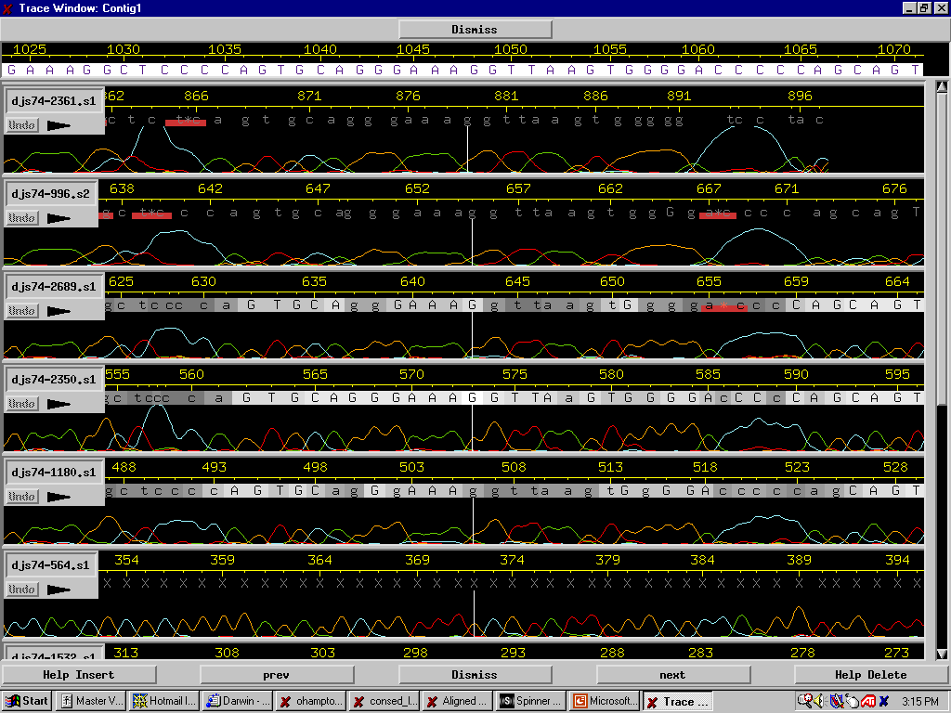
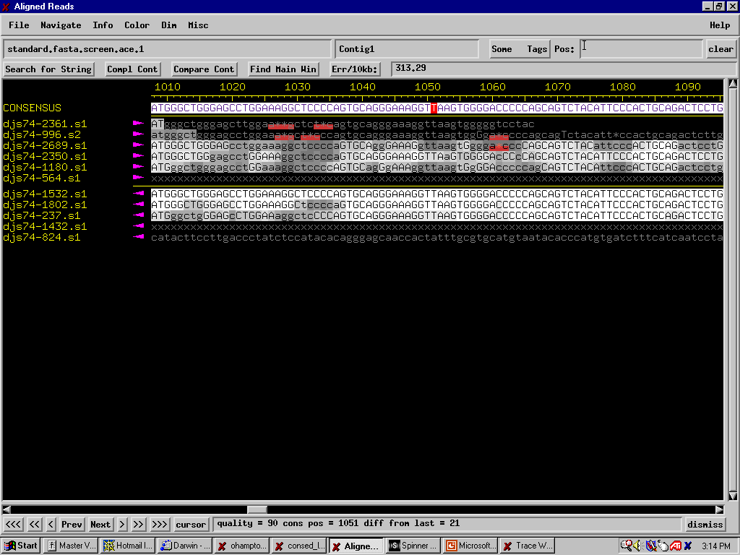
Tools for Shotgun Sequencing

Slide 34
Common Difficulty
Each of these problems is a method for modeling fragment assembly
Each of these problems is provably intractable
How?

Slide 35
Embedding problems
Suppose I told you that I had found a clever way to model the TSP as a shortest common superstring problem
  Paths between cities are represented as fragments
  The shortest path is the shortest common superstring of the fragments
If this is true, then there are only two possibilities:
  This problem is just as intractable as TSP
  TSP is actually a tractable problem!

Slide 36
NP-Complete Problems
There is a collection of problems that computer scientists believe to be intractable
  TSP is one of them
Each of them has been modeled as one or more of the other NP-complete problems
If you solve one, you solve them all
A problem, p, is NP-hard if you can model one of these NP-complete problems as an instance of p

Slide 37
NP-Completeness
NP
Set packing
Subset sum
3-SAT
TSP
P
Vertex cover
Graph 3-coloring
Bin packing

Slide 38
P = NP?
NP
Set packing
Subset sum
3-SAT
Vertex cover
NP
Graph 3-coloring
Bin packing
P

